Slide 1
Chapter Eleven Creativity, Innovation, and Leadership
LEADERSHIP
Andrew J. DuBrin, 7th Edition

Slide 2
Learning Objectives
Identify the steps in the creative process.
Identify characteristics of creative problem solvers.
Be prepared to overcome traditional thinking in order to become more creative.
Describe both organizational and individual approaches to enhance creative problem solving.
Explain how the leader and the organization can establish a climate that fosters creativity.
Identify several leadership practices that contribute to organizational innovation.

Slide 3
Creativity and Innovation
Creativity is the production of novel and useful ideas.
Innovation refers to the creation of new ideas and their implementation.
Organizational Creativity is the creation of a valuable, useful new product, service, idea, procedure, or process by individuals working together in a complex social system.

Slide 4
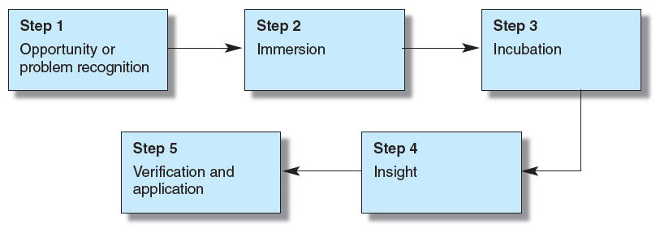
Steps in the Creative Process

Slide 5
QUIZ# 2
Note: Before attempting this quiz recall that a true leader is always an honest human being so without using any electronic means do attempt this quiz.
It will be instructive to share solutions with other classmates; for one thing, it helps to determine if your alternative use was not mentioned, or rarely mentioned, by others. Infrequent mention suggests a higher degree of imagination, although not necessarily practicality.
Creativity/Innovation “A standard technique for developing creativity is to find multiple uses for ordinary objects. In other words, the person doing the exercise is requested to go beyond conventional thinking in visualizing potential uses for a standard object. The point of the exercise is to develop skill in thinking flexibly. A basic example is that a soup bowl might also be used as a flower pot or paper weight. Working alone or using group brainstorming, identify about six potential uses for the following objects:
1. A paperclip*
2. A plastic tennis ball container
3. A shopping cart
4. An e-mail address
5. A pickup truck that no longer runs

Slide 6
Characteristics of Creative Leaders
KNOWLEDGE
Knowledgeable about a wide range of information
COGNITIVE ABILITIES
Highly intelligent
Intellectually curious
Able to think divergently
PERSONALITY
Nonconformist
Self-confident
Thrill-seeking
Energetic
Persistent
PASSION FOR THE TASK AND THE EXPERIENCE OF FLOW

Slide 7
Overcoming Traditional Thinking as a Creative Strategy
Creative problem solving requires an ability to overcome traditional thinking.
Traditional thinking generally refers to a standard and frequent way of finding a solution to a problem.
Central task in becoming creative is to break down rigid thinking that blocks new ideas.
“Thinking outside the box”
Do keep in mind, however, that group members need to know just how far they can venture from routine thinking.
Effective leaders establish parameters; even for their creative thinkers.

Slide 8
Individual Task /Assignment
HBR Reading 1: What Leaders Really Do
by John P.Kotter
Note: Attempt the above HBR reading with the one page one side summary, the same you did for The Speed of Trust
HBR Case Study 2 : Big Shoes to Fill
By Michael Beer
Note: After the thorough reading of the provided case study provide the solution against the questions asked at the end of the case study.

Slide 9
Organizational Methods to Enhance Creativity
Systematically Collecting Fresh Ideas
Employees furnish ideas into a company database
Brainstorming
Generate Quantity – Avoid Criticism – Combine and Improve on Previous Ideas – Combine and Improve on Previous Ideas
Using the Pet-Peeve Technique
Identifying all potential complaints from anyone who interacts with the group
Value comes from helping group improve its work processes
Equipping a Kitchen for the Mind
Allocating and stocking a specific space designed to nurture creativity – “a creativity room”

Slide 10
QUIZ# 3
Assessing the Climate for Creativity and Innovation
Instructions: Respond “mostly yes” or “mostly no” as to how well each of the following characteristics fits an organization familiar to you. If you are currently not familiar with an outside organization, respond to these statements in regard to your institute .
1.Company leadership wants workers to be creative.
2.People who contribute new and useful ideas often receive financial rewards.
3. Creative thinking is mostly the responsibility of people in creative jobs such as research and development, and marketing
4.Workers are encouraged to spend part of their time coming up with new ideas for products or services.
5.Creative types rarely get promoted.
6.The company invests considerable resources in innovation.
7.Few of our leaders appear to be innovative thinkers.
8.Innovative thinkers are publicly recognized in our organization.
9.People are often poked fun at for suggesting a unique idea.
10.Constructive change is welcome in this organization.
11.Many of our work groups are diverse both in terms of professional background and cultural factors.
Scoring and Interpretation: The score in the direction of a climate for creativity and innovation is “mostly yes” for statements 1, 2, 4, 6, 8, 10, and 11, and “mostly no” for statements 3, 5, 7, and 9. A score of 7 or higher suggests a climate well suited for creativity and innovation. A score of 4 to 6 is about average, and 3 or below suggests a climate that inhibits creativity and innovation.

Slide 11
Self-Help Techniques to Enhance Creative Problem Solving
Practicing creativity-enhancing activities
Staying alert to opportunities
Maintaining an enthusiastic attitude, including being happy
Maintaining and using a systematic place for recording your ideas
Playing the roles of explorer, artist, judge, and lawyer
Engaging in appropriate physical exercise

Slide 12
Establishing a Climate and Culture for Creative Thinking
Leadership Practices for Enhancing Creativity
Hire creative people from the outside and identify creative people from within
Intellectual challenge
Empowerment including freedom to choose the method
Ample supply of the right resources
Effective design of work groups
Supervisory encouragement and linking innovation to performance
Organizational support
Have favorable exchanges with creative workers
Give financial rewards for innovation

Slide 13
Establishing a Climate and Culture for Creative Thinking
Methods of Managing Creative Workers
Give creative people tools and resources that allow their work to stand out.
Give creative people flexibility and a minimum amount of structure.
Give gentle feedback when turning down an idea.
Employ creative people to manage and evaluate creative workers.

Slide 14
Additional Leadership Practices That Enhance Innovation
Emphasize transformational leadership if possible.
Continually pursue innovation.
Take risks and encourage risk taking.
Emphasize collaboration among employees.
Avoid innovation for its own sake.
Use loose-tight leadership.
Integrate development and production.
Recognize the hidden opportunities when products and ideas flop.

Slide 15
Summary
A creative leader brings forth ideas for things that did not exist previously.
The creative process involves five steps: opportunity or problem recognition, immersion, incubation, insight, and verification and application.
Having the right characteristics improves the chances of a person being a creative problem solver and a creative leader.
Creativity requires overcoming traditional thinking.
Creative thinking can be enhanced by systematically collecting fresh ideas and brainstorming.
Generating creative ideas has moral implications.
Establishing a climate conducive to creative problem solving is a requirement of effective leadership.

Slide 16
Group Task/ Assignment for All three Sections
Note: The all respective groups of three section would submit the report for the following topics along with their recorded ppt.
Section B: Explain the concept of “Super Leadership” & suggest any Muslim country which possess true leadership, also include relevant examples from world since 1900 onwards?
Section C : Carry out an in-depth analysis of current scenario of Pakistan & the current top leadership of Pakistan. What are the leadership flaws in the existing top leaders of Pakistan? Also suggest remedial measures to overcome them in future?
Section D: Suggest six biggest challenges, leadership of last hundred years across the globe have encountered?

Slide 17
Thank you

